Slide 1
B.a.c.k
Build a Computer for Kids

Slide 2
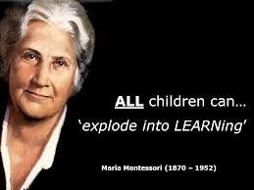
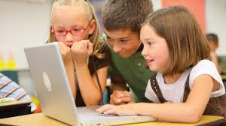
Why the need?
In the future all children will need a basic understanding of how a computer works.
This game will give a basic foundation of the major parts that make up a computer.

Slide 3
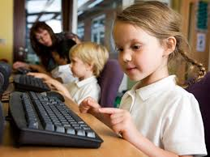
Who?
The game will be aimed at children 7 and under.

Slide 4

What?
The game will start with a splash screen with “Mikey” holding a bullhorn yelling at the children to start.
Music from a ‘90s’ themed cartoon will be playing.

Slide 5
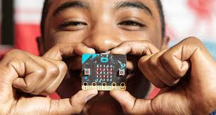
Behind the scenes
The game will have 4 subclasses of the world, 8 actor classes, and 10 subclasses that extend the actor classes.

Slide 6

Game instructions
Player presses enter to see main gaming environment.
The parts will be clickable and are to be dragged to the computer tower.
A timer will begin and they will have 30 seconds to complete the build.
Once they have finished and correctly built the computer the game will end.
The player will see a picture of Tristan and Kevin clapping to cheer them on.

Slide 7
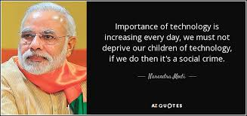
Conclusion
The game has many possibilities that can be built upon, this is only the beginning.
Our goal is to spark a child’s curiosity to want to know more about computers, how they work, and what they can do to make the computer do what they want it to do.

